Slide 1


TEAM MEMBERS
Sudheer Kumar Tatavalu
Anji Reddy Sattaru

Slide 2
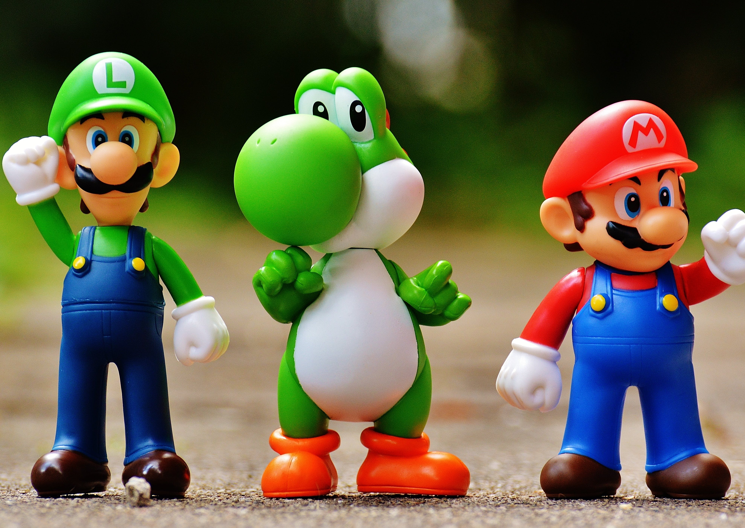
Reinforcement Learning for Mario: Teaching Mario to Play by Itself
"Building an Artificial Intelligence for Super Mario Bros."

Slide 3
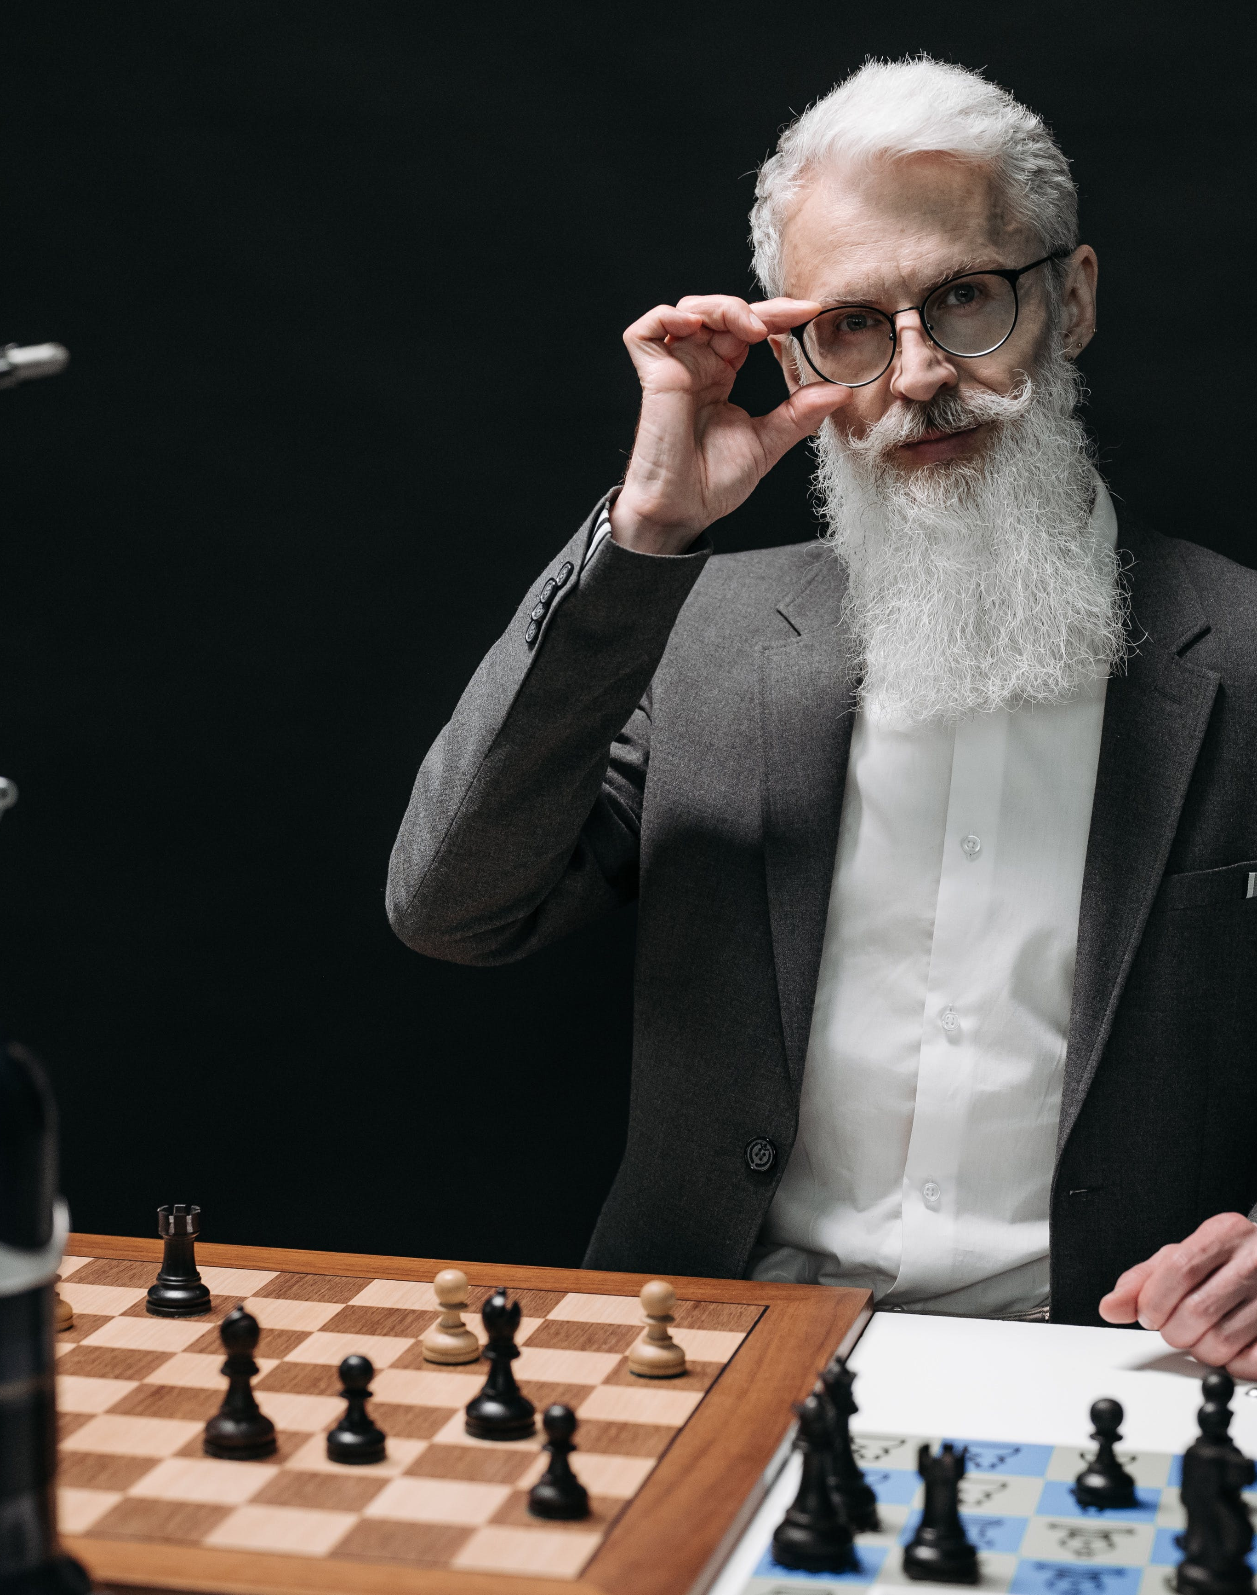
Statement of Project Objective
Teach Mario to Navigate: Train an AI agent to navigate through Super Mario Bros. levels autonomously.
Optimize Gameplay: Enable Mario to collect coins, defeat enemies, and complete levels efficiently.
Apply Reinforcement Learning: Utilize reinforcement learning algorithms, specifically Q-learning, to empower Mario's decision-making.

Slide 4
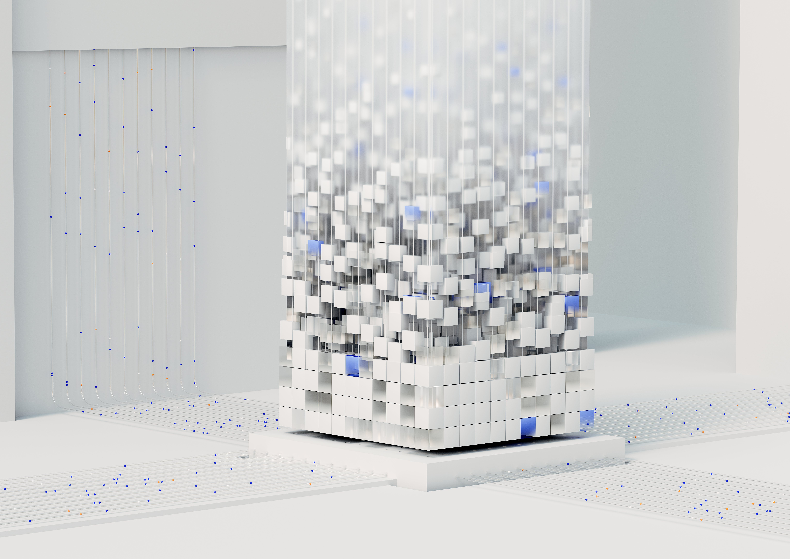
Approach
Tools:
Python: Main programming language.
OpenAI Gym: Interface with the Mario game environment.
NumPy: For numerical operations.
Techniques:
Q-learning Algorithm: Fundamental reinforcement learning technique.
NES-Py Library: Facilitates interaction with the NES emulator.
Game State Capture: Screenshots to capture Mario's state.

Slide 5

Deliverables
1. Python Script (mario_rl.py): Implementation of the Q-learning algorithm for training Mario.
2. Q-Table Data: A file or representation showing the Q-values learned during training.
3. Training Documentation: Report detailing the training process, parameter choices, and observations.
4. Testing Results: Data on Mario's performance during testing episodes.

Slide 6

Evaluation Methodology
Success Metrics:
Average Score: Evaluate Mario's average score over a set of testing episodes.
Level Completion: Assess Mario's ability to complete levels efficiently.
Visualization:
Gameplay Videos: Display videos showcasing Mario's performance during training and testing.
Training Progress Graphs: Charts illustrating the improvement in Mario's scores over training episodes.
User Feedback:
Subjective Evaluation: Gather feedback from users playing the game with and without the AI to assess its impact on player experience.

